Slide 1
Trauma Informed Peer Support
Centre for Excellence in Peer Support
Vimeo link: https://vimeo.com/432935662
Keely Phillips, MSW
June 2020
Original training by Washington P Silk, MSW 2016

Slide 2
About Keely and the Centre for Excellence in Peer Support
Notes:
Video: https://www.youtube.com/watch?v=P_uIoaRl5nQ
Why I work in peer support

Slide 3
Agenda
What Is Trauma?
Impacts of Trauma
Trauma and Mental Health and Addiction Systems
Peer Support & Trauma Informed Care
Practices of Trauma Informed Peer Support
Vicarious Trauma
Trauma Informed Use of Lived Experience
Practice Scenarios
Recovery and Post Traumatic Growth

Slide 4
Trauma informed practice
Trauma-informed practice means integrating an understanding of past and current experiences of violence and trauma into all aspects of service delivery. The goal of trauma-informed systems is to avoid re-traumatizing individuals and support safety, choice, and control in order to promote healing. Is not trauma treatment.

Slide 5
What is Trauma?
Notes:
Poll – how many people work with pwle of trauma?
Physical
Psychological

Slide 6
What is Trauma?
Is an emotional shock that overwhelms our abilities to cope making us go to into fight/flight or freeze response
Normal response to abnormal situations
Affects our brain chemistry
Experincing a trauma can cause mental health distress, that gets labels like PTSD, DID, BPD, addiction
Notes:
(Bloom & Fallot, 2009)

Slide 7
What is Trauma?
The DSM 5 Defines it as…
The person was exposed to: death, threatened death, actual or threatened serious injury, or actual or threatened sexual violence, as follows:
1. Direct exposure
2. Witnessing, in person
3. Indirectly, by learning that a close relative or close friend was exposed to trauma.
4. Repeated or extreme indirect exposure to aversive details of the event(s)
Notes:
The person was exposed to: death, threatened death, actual or threatened serious injury, or actual or threatened sexual violence, as follows:
1. Direct exposure
2. Witnessing, in person
3. Indirectly, by learning that a close relative or close friend was exposed to trauma. If the event involved actual or threatened death, it must have been violent or accidental.
4. Repeated or extreme indirect exposure to aversive details of the event(s), usually in the course of professional duties (e.g., first responders, collecting body parts; professionals repeatedly exposed to details of child abuse). This does not include indirect non-professional exposure through electronic media, television, movies or pictures.

Slide 8
Not all traumatic events = trauma response for everyone WHY?
Notes:
Why? What makes the difference? Why do some people develop PTSD and not others?
Discuss protective factors

Slide 9
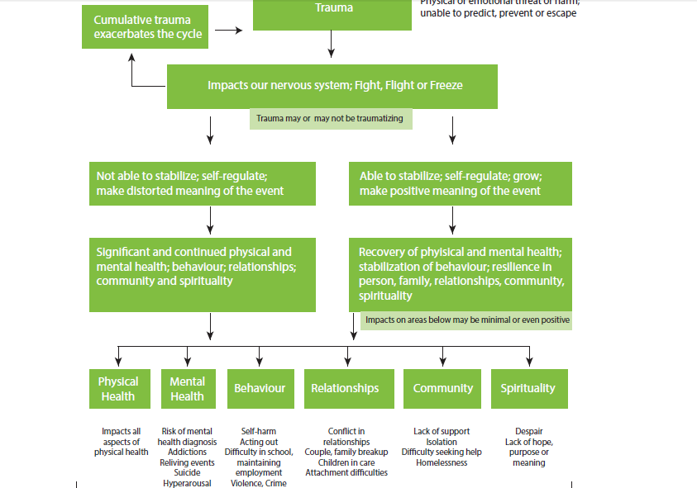
Notes:
http://trauma-informed.ca/wp-content/uploads/2013/10/Trauma-informed_Toolkit.pdf

Slide 10
Notes:
PRIMARY STATES
These are the three primary autonomic nervous system states.
At the top of the ladder is the safe/social system, responsible for social engagement, connection, critical thinking, problem solving and use of the head and neck area.
In the middle is the sympathetic flight/fight system, responsible for using the limbs for evasion or aggression.
And at the bottom is the shutdown system, responsible for collapse, death feign, dissociation and numbness.
MIXED STATES
It's possible for these primary states to mix as well.
Play = Safe/Social + Flight/Fight
Freeze = Flight/Fight + Shutdown
Stillness = Safe/Social + Shutdown
Feel free to download the image and share.

Slide 11
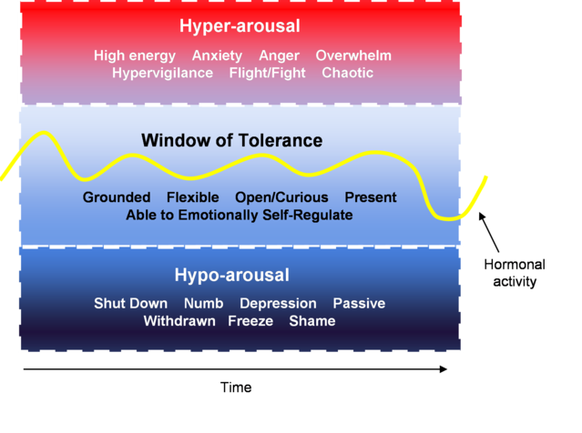
Window of Tolerance
https://www.psychologytoday.com/ca/blog/lifespan-psychology/202004/expanding-the-window-tolerance
Notes:
Wondow of tolerance = calm cool connected and collected

Slide 12
Memory & Trauma…
Notes:
https://www.youtube.com/watch?v=tHtGahbczIc
Psychology Tools

Slide 13
What does it look like?

Slide 14
Who can experience Trauma? How?
Individuals
Families
Communities
Notes:
Have individuals engage with what could cause a individual, family or community trauma response?
Individuals
-IPV, Sexual Assault, Neglect and Abandonment, disaster, death of some of close, any mis use of power
Families
-Death of a family member, IPV Community and school violence, bullying
Communities
-Residential Schools, War, Terrosim, Chronic stressors like racism or poverty, natural diasters

Slide 15
Why does being trauma informed matter in peer support?

Slide 16
Examples of community (systemic) trauma in the consumer survivor community…
Historical Experiences
Forced / coerced treatment
Institutionalization
No hope for recovery
Plus all the current issues….
Current Experiences
Lack of hope and compassion
Stigma
Difficulty finding and accessing help
Poverty, unemployment, and inadequate housing
Incarceration
Lack of continuity with treatment / workers
Lack of diversity of treatment options
Wait times
Medication and side effects
Marginalization of certain groups and culturally unsafe practices
Criminalization of drug use
Notes:
Being a peer means that we hear experiences in different ways – just as a clinical psychologist may hear view experiences in ways different from a social worker, or doctor
-

Slide 17
Trauma Stats
10% of woman and 5% of men are diagnosed with PTSD
Up to 1/3 of people exposed to trauma develop PTSD
Trends show that men have higher rates of trauma but woman have more childhood trauma and are more likely then men to develop PTSD
Of folks in substance abuse treatment, 12%-34% have current PTSD. For women, rates are 33%-59%.
Gender plays a role: For women, typically a history of sexual or physical childhood trauma; for men, combat or crime. No Research has been done on Trans folks.
PTSD associated with severe drugs; “self-medication” in 2/3 of cases (i.e., PTSD first, then substance abuse)
Notes:
Stats from Lisa M Najavistia PhD 2012 https://ncc.expoplanner.com/files/7/SessionFilesHandouts/E19_Najavits_1.pdf
Transpulse project: we estimated that suicidal thoughts were experienced by 36% of trans Ontarians over the past year, and that 10% attempted suicide during that time.

Slide 18
Why Getting Help is Hard…
Organizations are not trauma informed
PTSD does not go away with abstinence
Cannot be treated only within the medical model
Still some separate treatment systems for mental health and addiction; not all help is publicly funded
Notes:
“Social services have a habit of instigating/facilitating "bad" behaviours by people who come to us for help. We do it with our bureaucracy, surveillance and paternalistic approaches, but we really struggle to take real responsibility. Instead of noticing the ways we co-create these «incidences», the stories we tell sound like "that client stole from us and my program suffers" or "that client is banned from our services" and few stories are nuanced with "she was greeted by an... under supported curt volunteer who asked her a shaming question, it was the 3rd time she left our place with her head down low" or "my organization deserves to be given the finger” or “we are overworked, so we miss a lot of important things” or "I feel so insecure at work that I have to prioritize my relationship with my coworkers over advocating for service users". We forget key pieces in the way we retell stories, placing blame on individuals, re-enforcing our allegiances and keeping institutional power intact, “client-centered” are we? “ – anonymous

Slide 19
Power and Privilege
Power dynamics in society keep trauma experiences invisible:
Poverty
Racism
Ableism
Saneism
Homophobia
Stigma
Victim blaming
Child welfare systems
Notes:
the US, rates of PTSD do not differ by race (Kessler et al., 1995). Substance abuse: Hispanics and
African-Americans have lower rates than Caucasians; Native Americans have higher rates than Caucasians
(Kessler et al., 1995, 2005). Rates of abuse increase with acculturation. Some cultures have protective
factors (religion, kinship).
It is important to respect cultural differences and tailor treatment to be sensitive to historical prejudice.
Also, terms such as “trauma,” “PTSD,” and “substance abuse” may be interpreted differently based on culture.

Slide 20
Experiencing Trauma Within the Mental Health System…
When people do reach out for help they may have felt re-traumatized by some mental health responses ( eg loss of power and rights, seclusion and restraints, etc) it is not surprising to find that many people struggle or have complicated feelings when reaching out for help.
Notes:
Reference: A Narrative Approach to Developing Standards for Trauma Informed Peer Support

Slide 21
Core Principles
Core Principles of Trauma Informed Care Safety (Physical and Emotional) Trustworthiness Choice Collaboration Empowerment (Fallot & Harris, 2006) | Peer Support Values and Principles Empowerment Hope Self Determination Elimination of Prejudice and Discrimination Meaningful Choice
Notes:
Do you see any similarities?
Adapted from Sherry Mead
(Fallot & Harris, 2006)
http://onlinelibrary.wiley.com/doi/10.1002/yd.23320018904/abstract
May choose to hand out copies of the Values & Principles document at this time, or direct audience to copies available in the room.
Value Empowerment - The system will provide opportunities for individuals to exercise control and power with respect to their lives.
Value and Elicit Hope - Recovery cannot occur without hope. The system will encourage hope and in doing so will focus on skills and abilities.
Value Self Determination - The system will recognize and accept that individuals will make their own decisions about their life and they will be in control of those decisions.
Work toward the Elimination of Prejudice and Discrimination - The system will work toward the elimination of prejudice and discrimination toward people with mental health and addiction issues.
Value Meaningful Choice - The system will recognize and accept that individuals have an unlimited number of choices from which to make their own decisions about their life. All individuals are entitled to the dignity of risk that is inherent in making choices.

Slide 22
Operate on an Empowerment Model
Understand the role of trauma in people’s lives
Facilitate Healing
Respect Voice and Choice
Work with Survivors in a Collaborative Way with Mutual Goals
Minimize Re-Traumatization
Meet the Survivor Where They Are At
See Adaptive Behaviors as Strength and with Purpose
Trauma Informed Peer Support Aim (Mead, 2008)
Provides reciprocal receiving and giving of support
Fosters relationships that establish new ways of understanding their experiences
Eliminates the power differential inherent in traditional mental health settings/clinical relationships
Builds on shared experience and mutual exchange
Notes:
https://www.power2u.org/alternatives2010/downloads/Trauma-InformedPeerEngagement.pdf
not as clinical pathology rather as understandable reactions to trauma.

Slide 23
How does a peer worker do all that?
Qualities essential to working with people who have experienced trauma
Empathy
Compassion
Ability to talk openly and honestly
Self-awareness
Flexibility
Comfort ability with the unknown
Willingness to learn
Willingness to emotionally connect
Ability to treat folks as equals
Mutuality and collaboration
Self-care
Doing your own emotional work
Notes:
Reference: http://trauma-informed.ca/wp-content/uploads/2013/10/Trauma-informed_Toolkit.pdf

Slide 24
Approach and Language
Not Trauma Informed My illness What is wrong with me? My client/consumer I am here to help you Further along in recover (same as high and low function) Coping Safety is defined as risk management Helpers decide what helps looks like Relationship is based on problem-solving and accessing resources | Trauma Informed My Experiences What has happened to me? People I work with… I am here to learn with you Risking new thinking/ behavior Change patterns Safety is defined by the person People choose the help they want Relationship is based on autonomy and connection
Adapted from Sherry Mead 2008

Slide 25
Peer Support is Unique
Due to stigma you might be the first person they are reaching out to help understand their experiences: mutuality
Offer an alternative to the medical model
No assessments or evaluation
Peer support values
Person centered
Notes:
This is seen in veterans, buddy to buddy, a citizen solder peer support program – where usually people only reach out to their own

Slide 26
Peer workers do not fix people… fixing = disconnection and power over
When you speak to me about your deepest question, you do not want to be fixed or saved: you want to be seen and heard, to have your truth acknowledged and honored. If your problem is soul-deep, your soul alone knows what you need to do about it, and my presumptuous advice will only drive your soul back into the wood.” - Parker Palmer
Notes:
Fixing = removing control

Slide 27
Trauma Experiences Disconnect People…
By…
Making people feel powerless
Unable to trust or form close relationships
Impact relationships with self, others communities (avoidance of triggers)
Creates distance between people (isolation)
Notes:
Adjusted from Bringing Trauma Informed Practices to Peer Support, Mental Health Empowerment Project
Eva Dech and Darby Penny

Slide 28
13 Things Peers Workers Do that Cause Disconnect…
Ordering, directing
Cautioning
Wanting to make a difference
Arguing or lecturing
Telling people what they should demoralizing
Being unaware of your own power
Agreeing, approving, praising
Over relating
Interpreting or analyzing
Reassuring or sympathizing
Questioning or probing
Withdrawing, joking or changing the subject
Steering the conversation or pushing your own agenda
Shery Mead 2008
Notes:
Are their any in here that look familiar to you?

Slide 29
Trauma glasses off | Trauma glasses on
Manipulative. | Getting needs met in ways that have worked in the past. Doing whatever is necessary to survive.
Lazy | Overwhelmed. Lacking the skills to make decisions about what to do first or to organize
Resistant | Mistrustful of others due to history of being hurt by others. Scared to make progress and then lose everything
Unmotivated | Depressed. Fearful. Overwhelmed. “Frozen.”
Disrespectful | Feeling threatened, unsafe, out of control.
Attention-Seeking | Feeling disconnected, alone, or unheard by others. Looking for connection.

Slide 30
What is Vicarious Trauma?
Vicarious traumatization can be thought as when a peer helper is emotionally engaged and working with folks who experience Trauma and it can shift or disrupt your sense of hope and meaning in your life.
Compassion Satisfaction Scale
Notes:
Refer to Professional Quality of Life Scale

Slide 31
Vicarious Trauma
Evidence also shows helping professionals who are engaged, committed and emotionally present are more at risk for vicarious trauma.
Further evidence shows that for peers if their work place culture does not emphasize person centered care, self determination and hope they are less likely to receive the benefits of post-traumatic growth and the humanistic growth of mutual aid.
Notes:
Reference: Facilitating Positive Emotional Labor in Peer-Providers of Mental Health Services
Michael Mancini and Hal Lawson
Evidence shows that those most at risk for Vicarious Trauma:
Hold themselves personally resposible for the troubles situation even when no one could reasonable be expected to master it. Many workers can relate to this feeling: you lnow in your gut that there is only so much you can do, but you still feel responsible in some way.
Individuals pereeive that the traumatic event itself will be long-lived – they see no possibility of relief
Individuals belive that they are likely to repreat their current struggles in another time and place

Slide 32
16 Warning Signs of Trauma Exposure Response
Feeling Helpless and Hopeless
A Sense That One Can Never Do Enough
Hypervigilance – everything needs to happen now!
Diminished Creativity
Inability to Embrace Complexity
Minimizing
Chronic Exhaustion/Physical Ailments
Inability to listen/deliberate avoidance
Dissociative Moments
Sense of Persecution
Guilt
Fear
Anger and Cynicism
Inability to Emotionally Empathize/Numbing
Addiction
Grandiosity
Notes:
Trauma Stewardship: An everyday Guide to Caring for Self While Caring for Others

Slide 33
Do’s of Trauma Informed Practice
Invite conversation
Allow silence
Allow expression of emotions
Stay with survivor in their pain
Ask “What can I do for you now & later Say “I don’t know” (answering, “why did this happen to me” etc.)
Ask what has brought comfort in the past and if this can be accessed now.
Reflect and clarify to be sure you understand
Ask, “what should I ask you?”
https://dhhr.wv.gov/bhhf/ibhc/Documents/Presentations1115/BH%20conferenceTICPrinciples%20%20Case%20Examples%20FINAL.pdf

Slide 34
Don’ts of Trauma Informed Practice
Demand eye contact
Get too close
Talk too much
Ask too many questions
Make promises you cannot keep (I’ll make sure you are safe.) Use platitudes (this will make you stronger later)
Say, “you should be over this by now,” or “you have to forgive the perpetrators(s) so you can start to heal.”
Touch without spoken permission
Talk about your own trauma…without permission from the survivor
Ask survivor to tell you about the traumatic incident(s)

Slide 35
Your Lived Experience Sharing Is Not Trauma-Informed if it…
Names people or describes people in detail, or describes a traumatic event in detail
Glorifies any traumatic experience including systemic trauma (poverty) or unhealthy practices/choices
Is more about how bad it got than it is about my recovery and how I got better
Reinforces myths or stereotypes or oppressive structures
Isn’t developmentally suited to the audience (e.g., youth / children vs adults)
Is an advertisement for a service or medication or treatment

Slide 36
Trauma Informed Peer Support
Name and validate past experiences of trauma
Explore impact on life now
Share healing strategies

Slide 37
Focus on the impact of the trauma now, not what happened then… Gladys mostly wants to talk about the details of what happened to her. She has a tough time talking about her life now. What could you say?
“Gladys it sounds like what happened to you is really sticking with you. I am glad you want to talk to me about it. When you talk about your experience can you please not go into too many details? I want to be able to listen to you fully and worry that too many details will bring up my own past traumas.”
“Gladys would you tell me about how what you experienced is impacting on your life now?”
“Gladys I am so sorry for the things your experienced in the past. I have experienced tough things to, including abuse. While I won’t share details, I am happy to share some of what helped me through it.”
Notes:
Do in small groups – brainstorm what EFA looks like

Slide 38
In peer support group a member begins to go into detail about a car accident they were in. Group members are interested. What do you say to the group?
Facilitator: “We can talk about what happened if Chris wants to, but without details. Let’s not ask questions about details and let’s keep each other safe by not painting a picture of what happened.”
Chris “there was a car accident and my spouse is still very severely injured and in a wheelchair from it”
Group member “What a terrible experience the car accident sounds like. Life now sounds more difficult” ← invites exploration of loss, and other impacts of trauma, then conversation can flow to current coping and posttraumatic growth

Slide 39
Setting a boundary later… Ahbed wants to talk about his terrifying nightmares, at first it was interesting for you to hear but you now feel you need to set a boundary with him.
“Ahbed, I know that last time we talked you shared details of your nightmares with me and I was interested. Afterwards I spent a lot of time thinking about the details of what you shared with me. It really stuck with me. I can imagine how hard this has been for you. I want to ask that in our future conversations we talk about how this trauma impacts on your life without the details of the nightmares? We can talk about how the nightmares are impacting on you without the details of what goes on in them.
Name and validate past experiences of trauma
Explore impact on life now
Share healing strategies

Slide 40
The Good News… Post Traumatic Growth
“Posttraumatic growth relates to the experiences of positive change that results specifically from highly challenging life crisis. Posttraumatic growth may include enhanced personal strength, appreciation of life, improve relationships, spiritual change, new opportunities. “
Notes:
Taken from: Toward Understanding the Impact of occupation Characteristics on the Recovery and Growth Process of Peer Providers Galia S Moran and Zlatka Russinova and Katherine Stepas

Slide 41
Your Lived Experience…
“You talk to another survivor and what takes you two years to explain to your therapist you can say in two minutes to another survivor.”
Notes:
Ann Jennings, Ph.D. and Ruth O Ralph, Ph.D., Eds. In Their Own Words: Trauma Survivors and Professionals They
How do you think your lived experience helps someone share their trauma experience?

Slide 42
References:
Fallot, R. (2011). The impact of trauma on wellness: Implications for comprehensive systems change. SAMHSA webinar.
Fallot, R. & Harris, M. (2009). Creating cultures of trauma-informed care (CCTIC): A self-assessment and planning protocol. University of Iowa: Community Connections.
Mancini M & Lawson H. (2009). Facilitation Positive Emotional Labor in Peer-Providers of Mental Health Services. Administration in Social Work.
Frank Reissman.(1965). The “Helper” Therapy
Bledsoe C. (2001) Principal Unique Eyes and Different Windows of Opportunity: The Consumer Provider Perspective. The Haworth Press.
Mowbray & Et Al. (1998). Consumer as Mental Health Providers: First-Person Accounts of Benefits of Limitations. The Journal of Behavioral Services & Research
Gredden J &Et All. (2010). Buddy-to-Buddy, a citizen solider peer support program to counteract stigma, PTAS, depression and suicide. Association for Research in Nervous and Mental Disease
Moran G & Et al. (2011) Benefits and Mechanism of Recovery Among Peer Providers with Psychiatric Illness. Qualitative Health Research.
Moran G. (2012). Toward Understanding the Impact of Occupation Characters on the Recovery and Growth Processes of Peer Providers. American Psychological Association.
Mead Shery & Macneil C. (2005) A Narrative Approach to Developing Standards for Trauma Informed Peer support. American Journal of Evaluation.
Sherry Mead Consulting (2008)
Christine Deneweth (2015). All About PTSD. Everyday Feminism
Trauma and The Brain. www.getselfhelp.co.uk
Flight or Fight Response. Psychology.tools
PTSD & Memory Psychology Tool
Najavita LM (2002) Seeking Safety: A treatment Manual for PTAS and Substance Abuse. Dealing with the Effects of Trauma – A Self – Help Guide SAMHSHA
National Center on Trauma-Informed Care (2012). Engaging Women in Trauma-Informed Peer Support
Trauma Informed Tool Kit (2013). KLINC http://trauma-informed.ca/wp-content/uploads/2013/10/Trauma-informed_Toolkit.pdf

Slide 43
Contact Information
Keely Phillips, MSW
Manager Self Help & Peer Support and Centre for Excellence in Peer Support
kphillips@cmhaww.ca
Cmhawwselfhelp.ca
519 570 4595 ext 5021
Twitter: @phillipskeely

